Slide 1

Data Safety Analysis
Key Concepts
11th February 2026
Dr. Divya Atkins
divya@mca-ltd.com

Slide 2
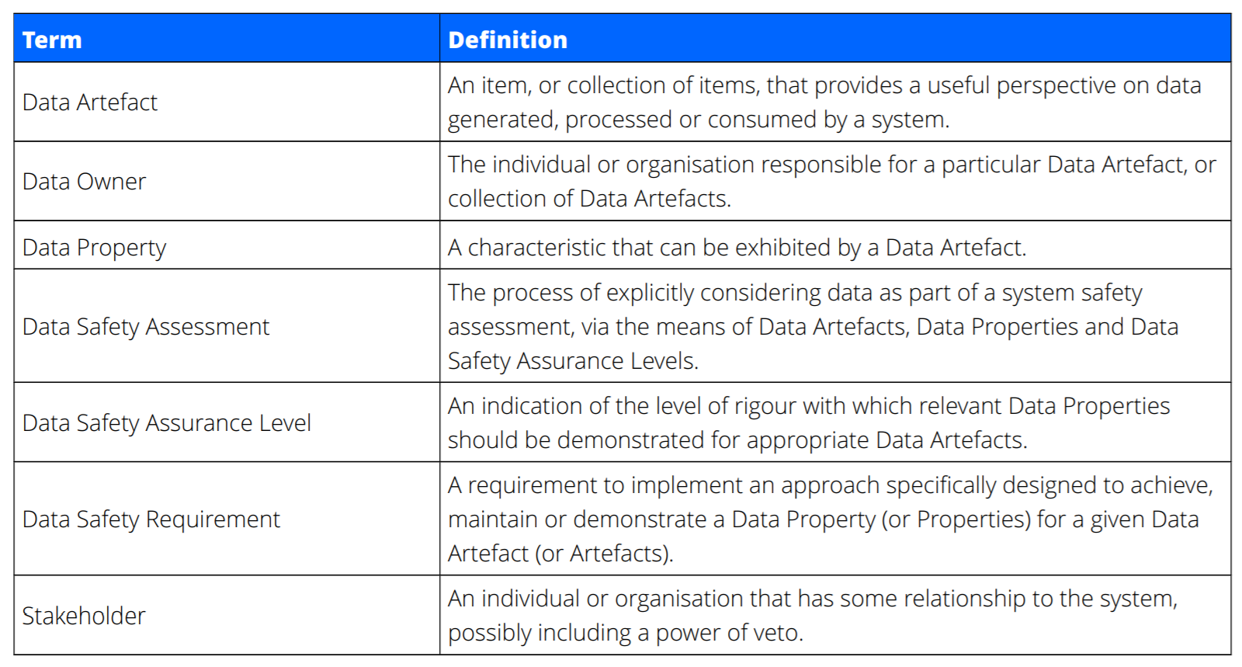
Definitions

Slide 3






Analysis Framework and Process
Organisational
System-level
Data Safety Management Process:
Goal: Derive Data safety requirements
Determine effective mitigations for risks associated with the use of data
4.
Evaluate and Treat Risks
1.
Establish Context
2.
Identify Risks
3.
Analyse Risks

Slide 4
Establish Context
Who are the stakeholders?
Organisation
  Organisational Data Risk (ODR)
  Data Safety Culture
System
  Producers and Consumers of Data
  Data Supply Chains
What are the Data Artefacts of interest?
What interfaces does the system have?
Output: Data Safety Management Plan
Establish

Slide 5
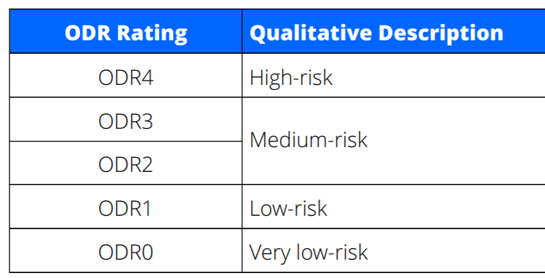

Organisational Data Risk Assessment - ODR
From the perspective of ONE organisation
Completed for each instance, scope, project...
Used in early phases of procurement or project definition
Establish
Quantitative
Qualitative
  Q1 – Severity and Proximity
  Q2 – Organisational and Societal Impact
  Q3 – Responsibility
  Q4 – Legal and Regulatory Framework
  Q5 – Organisational Maturity
  Q6 – Ownership and Usage
  Q7 – Size, Complexity and Novelty
  Q8 – Boundaries and Interfaces

Slide 6
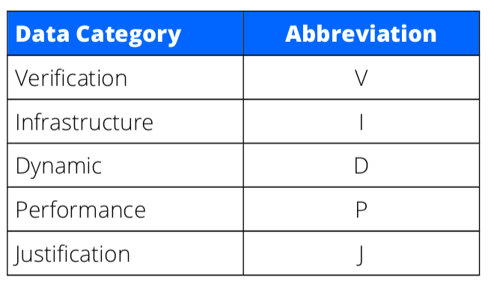
Categories of Data Artefacts
Establish
Examples
A test result
IP address
Blood pressure
A&E wait time
...
Lifecycle stage also determines Data category​
Output of this Phase: List of Data artefacts

Slide 7
Identify Risks
Review relevant historical mishaps
List Risks
  Link to Data Artefacts
  Data category: Lifecycle context
  What properties of the data are lost?
Top-down
  Safety-related functions
    Which Data Artefacts
    What Data Properties
Bottom-up
  Use HAZOP guidewords
Identify

Slide 8
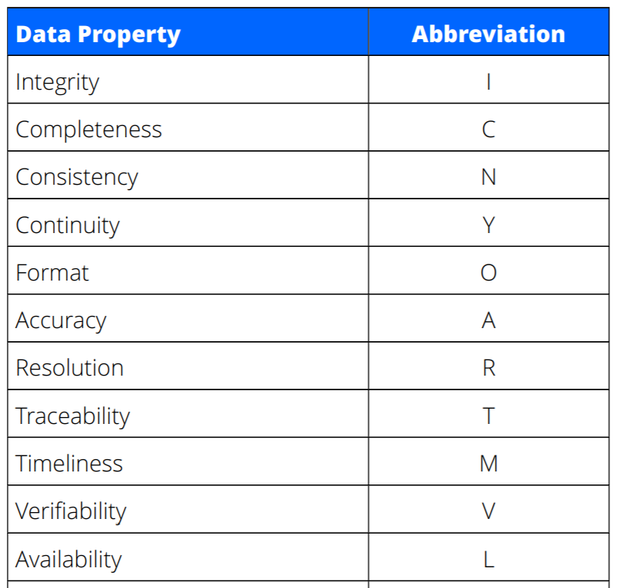
Data Safety Properties
The loss of some of these, can cause risks
Common outcomes may allow grouping one or more properties
Identify

Slide 9
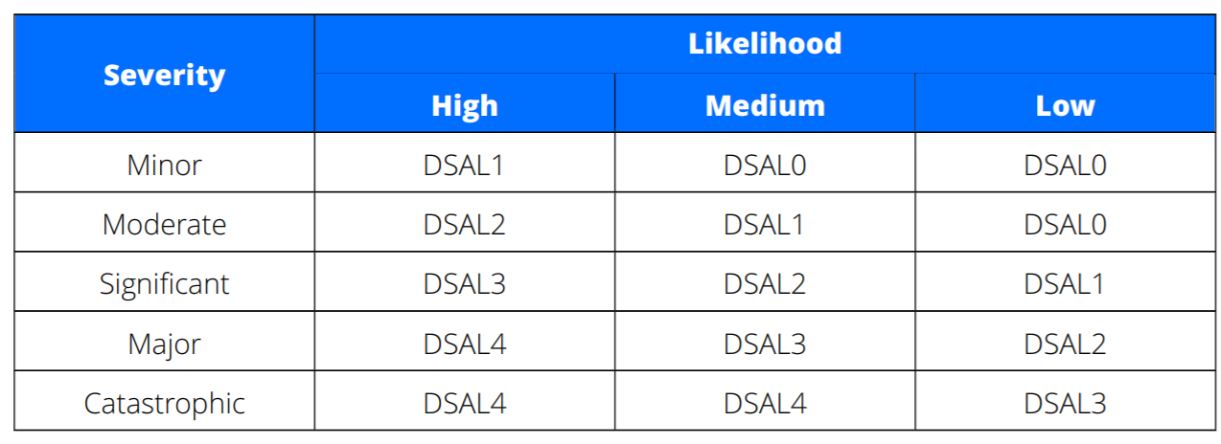
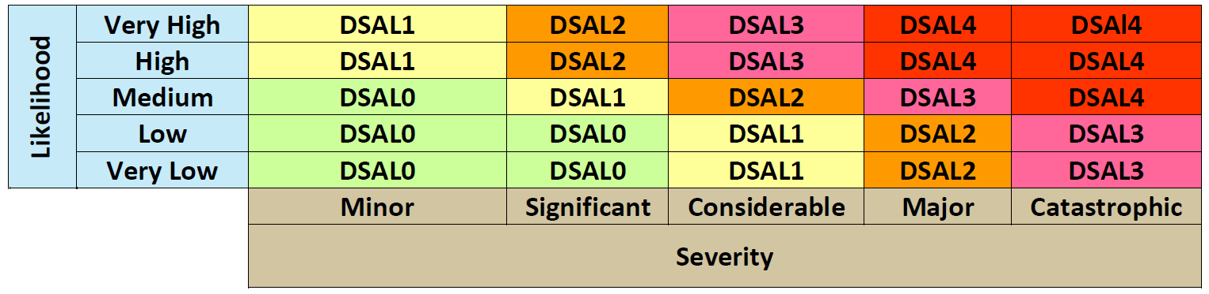
Analyse Risks
Analyse
Justify Analysis
For each risk, establish Data Safety Assurance Level
Mapping into NHS Digital DCB 0160 scheme

Slide 10




Evaluate & Treat Risks
Evaluate
& Treat
Record responses to each risk, with justification
For each risk:
Demonstrate compliance with requirements
  Has risk been suitably mitigated?
  Plan further mitigation, if needed
Add system requirements to treat each risk
Record treatment for each risk,
with evidence of implementation
Avoid
Accept
Transfer
Treat

Slide 11
Treating Risks
Each Data Artefact
  Has a Category
    Dynamic, Verification, ...
  The loss of its Data Safety Properties cause a Risk
    Integrity, Accuracy, Timeliness, Continuity, ...
  The Likelihood and Severity of the Risk imply a DSAL
These define appropriate mitigation techniques
  They can be Recommended (R)
  Or Highly Recommended (HR)
Evaluate
& Treat

Slide 12
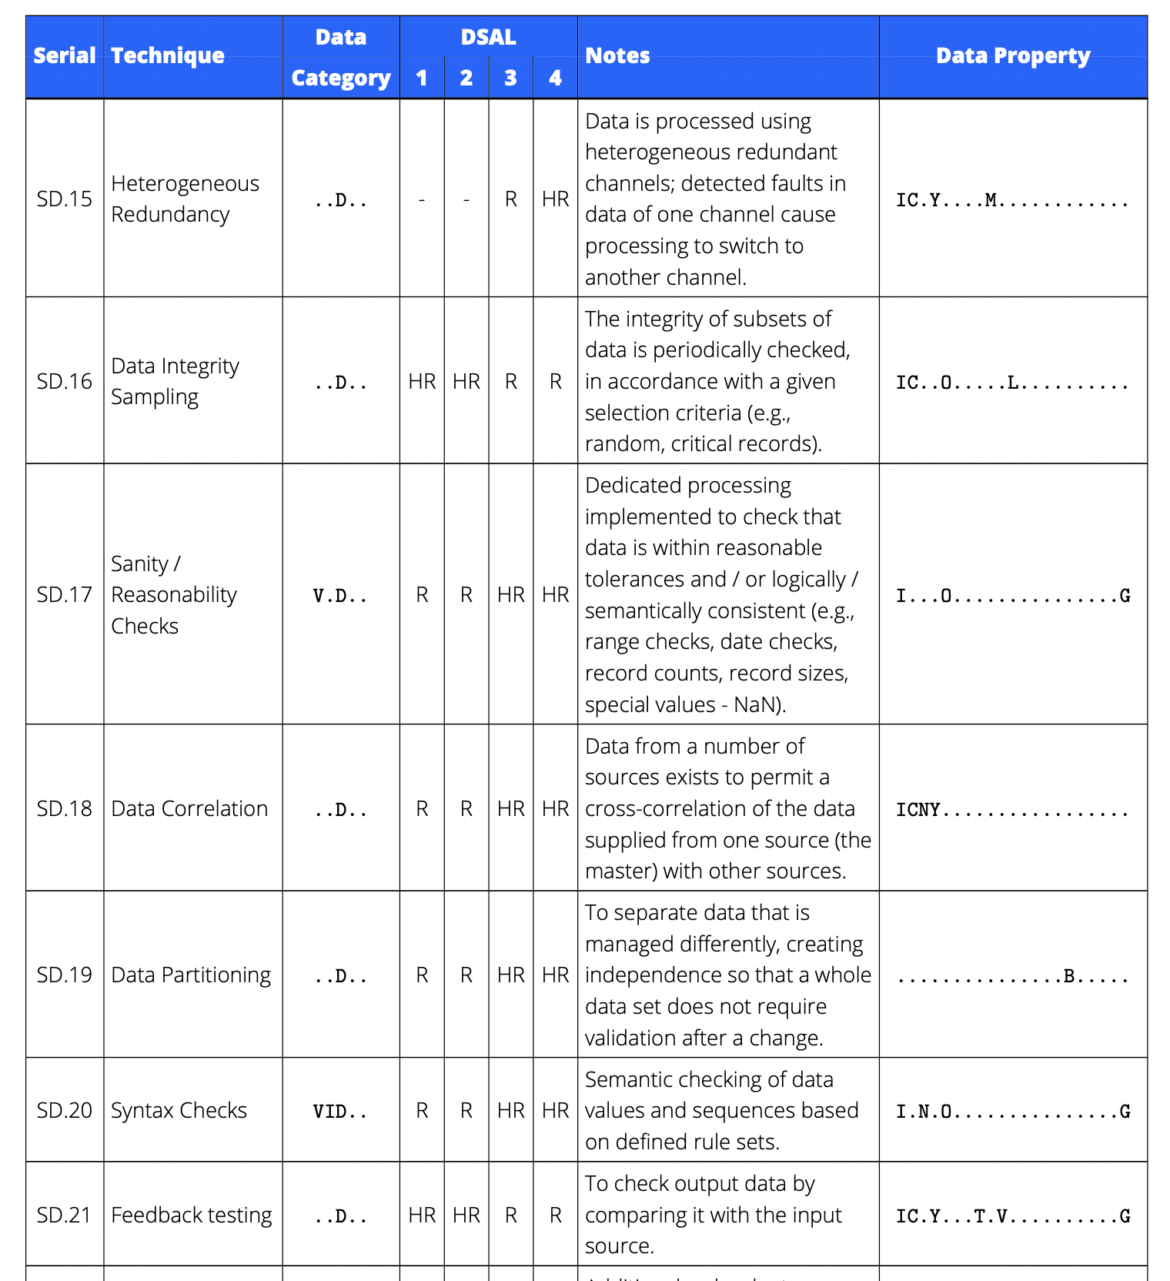
Mitigation Techniques
Evaluate
& Treat
100+ mitigation techniques available
Complex: Needs tool support!

Slide 13
Recap
Data is important, and needs careful management
A rigorous data safety analysis will result in safer outcomes
Best practice guidance is available and should be part of risk management
Organisational
System-level
Data Safety Management Process:
1.
Establish Context
2.
Identify Risks
3.
Analyse Risks
4.
Evaluate and Treat Risks

Slide 14
Visit
data-safety.tech
For
Link to DSIWG Guidance
Searchable Accidents database
Additional Resources
Registration and login for RADISH tool
www.mca-ltd.com

